Slide 1
Large Scale Data Processing
Ramesh Ragala
VIT Chennai

Slide 2
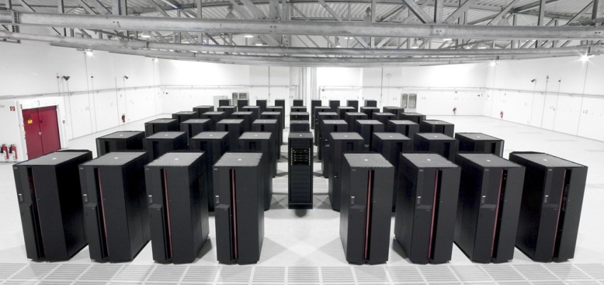
Hadoop - Introduction
An Open source software framework (Apache Project)
Originally developed by Yahoo (but originated from Google)
Goal:
storage and processing of data-sets at massive scale
Infrastructure:
clusters of commodity hardware
Core Components:
HDFS → distributed file system
Map Reduce → programming model for large scale data processing
Eco Systems
Pig, Hive, Hbase, mahout, zookeeper

Slide 3
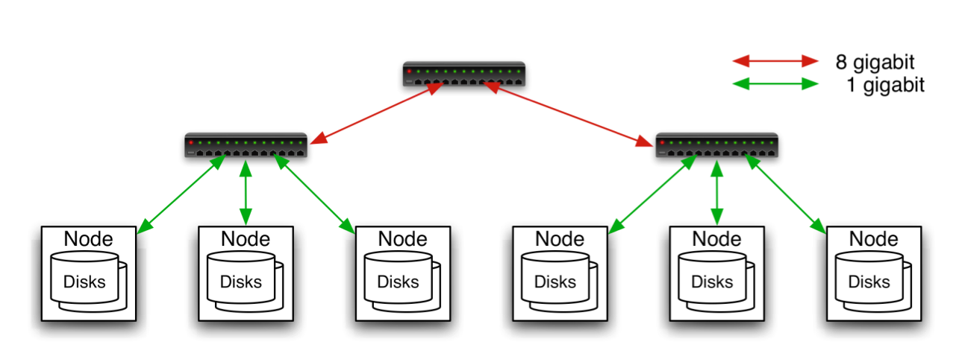
Commodity Hardware
Aggregation switch
Rack switch
It involves the use of large numbers of already-available computing components for parallel computing, to get the greatest amount of useful computation at low cost
Typically in 2 level architecture
Nodes are commodity PCs
30-40 nodes/rack
Uplink from rack is 3-4 gigabit
Rack-internal is 1 gigabit

Slide 4
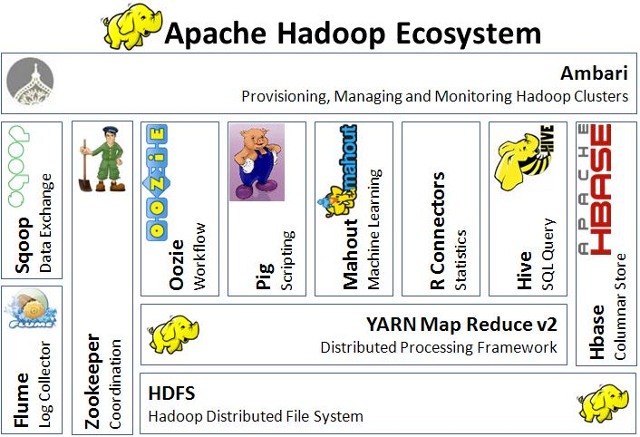
Hadoop - Ecosystem

Slide 5
Hadoop - History
2003: Google publishes about its cluster architecture & distributed file system (GFS)
2004: Google publishes about its MapReduce programming model used on top of GFS
Written in C++
closed-source, Python and Java APIs available to Google programmers only
2006: Apache & Yahoo! → Hadoop & HDFS (Doug Cutting and Mike Cafarella)
open-source, Java implementations of Google MapReduce and GFS
a diverse set of APIs available to public
2008: becomes an independent Apache project
Yahoo! uses Hadoop in production

Slide 6

Hadoop users

Slide 7
What is HDFS
Hadoop Distributed File System
Data is organized into files and directories
Files are divided into uniform sized blocks (default 128MB) and distributed across cluster nodes
HDFS exposes block placement so that computation can be migrated to data
Blocks are replicated (default 3) to handle hardware failure
Replication for performance and fault tolerance (Rack-Aware placement)
HDFS keeps checksums of data for corruption detection and recovery
Good for
Large files
Streaming Data Access
Bad for
Lots of small files
Random Access
Low – Latency Access

Slide 8
What is HDFS
HDFS is a Java-based file system that provides scalable and reliable data storage, and it was designed to span large clusters of commodity servers
HDFS has demonstrated production scalability of up to 200 PB of storage
HDFS has demonstrated a single cluster of 4500 servers, supporting close to a billion files and blocks.
HDFS is a scalable, fault-tolerant, distributed storage system that works closely with a wide variety of concurrent data access applications, coordinated by YARN.

Slide 9
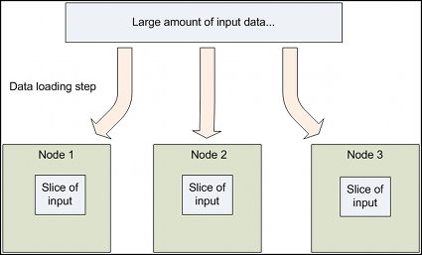
Design of HDFS
GFS like Design
HDFS supports parallel reading and processing of the data
Read, Write, Rename and Append
Optimized for streaming reads/writes of large files
Master – Worker Architecture
Master
Single Name node for managing FS meta
Slaves
Multiple Data Nodes for storing data
One more:
Secondary name node for check-pointing

Slide 10
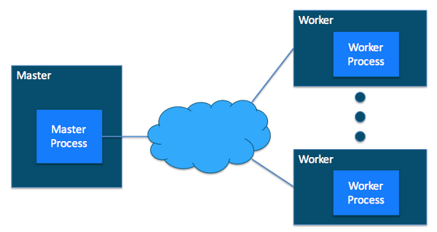
Design of HDFS

Slide 11
Design of HDFS
HDFS is a filesystem designed
For storing very large files with streaming data access patterns
running on clusters of commodity hardware
Very large Files:
Files that are hundreds of megabytes, gigabytes, or terabytes in size.
Streaming data access:
It built on an idea: write-once and read-many times
A dataset is typically generated or copied from source, and then various analyses are performed on that dataset over time.
Commodity Hardware:
Hadoop doesn’t require expensive, highly reliable hardware.
It can be execute on cluster of commodity hardware --> chance of node failure is more .
HDFS is designed to carry on working without a noticeable interruption to the user in the face of such failure.

Slide 12
Design of HDFS
Set of Applications where HDFS does not work well:
Low-latency data access:
HDFS is optimized for delivering a high throughput of data, and this may be at the expense of latency.
HBase is currently a better choice for low-latency access.
Lots of small files:
Because the namenode holds filesystem metadata in memory, the limit to the number of files in a filesystem is governed by the amount of memory on the namenode.
As a rule of thumb, each file, directory, and block takes about 150 bytes.
Example: if you had one million files, each taking one block, you would need at least 300 MB of memory.
Although storing millions of files is feasible, billions is beyond the capability of current hardware.

Slide 13
Design of HDFS
Set of Applications where HDFS does not work well:
Multiple writers, arbitrary file modifications:
Files in HDFS may be written to by a single writer.
Writes are always made at the end of the file, in append-only fashion.
There is no support for multiple writers or for modifications at arbitrary offsets in the file.

Slide 14
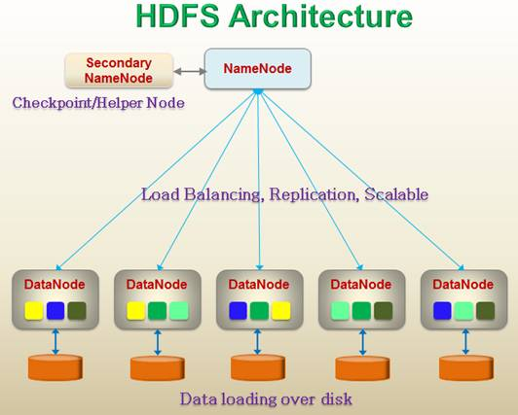
HDFS Architecture

Slide 15
HDFS Master (Name Node)
Manages filesystem namespace tree and holding the entire namespace tree in RAM --> 2 files --> namespace image and edit log
Maps a file name to a set of blocks
Maps a block to the DataNodes where it resides
Files and directories are represented by i-node
Mapping i-node to list of blocks + locations
Authorization & Authentication
Checkpoint & journal namespace changes
Mapping of Data node to list of blocks
Monitor Data node health
Actively monitors the number of replicas of block and replicate missing blocks
Keeps ALL namespace in memory
It also executes file system operations such as renaming, closing, and opening files and directories.
Cluster Configuration Management
Types of Meta Data:
List of Files
List of Blocks for each files
List of data nodes for each block
File attributes like.. Creation time, replication factor, etc.

Slide 16
HDFS (Data Node)
Handle block storage on multiple volumes & block integrity
Clients access the blocks directly from data nodes
Periodically send heartbeats and block reports to Name node
Blocks are stored as underlying OS’s files

Slide 17
HDFS
Without the namenode, the filesystem cannot be used.
The machine where namenode is running is failed -->
All the files on the filesystem would be lost --> since there would be no way of knowing how to reconstruct the files from the blocks on the datanodes.
For this reason, it is important to make the namenode resilient to failure, and Hadoop provides 2 mechanisms for this.

Slide 18
HDFS
Ist Approach:
In this approach, back up the files that make up the persistent state of the filesystem metadata.
Hadoop can be configured so that the namenode writes its persistent state to multiple filesystems.
These writes are synchronous and atomic.
The usual configuration choice is to write to local disk as well as a remote NFS mount

Slide 19
HDFS (Secondary Name Node)
IInd Approach:
Runs a secondary namenode, which despite its name does not act as a namenode.
Its main role is to periodically merge the namespace image with the edit log to prevent the edit log from becoming too large.
It runs a separate physical machine because it requires lot of CPU and much memory as the namenode to perform the merge.
It keeps a copy of the merged name‐space image, which can be used in the event of the namenode failing.
However, the state of the secondary namenode lags that of the primary, so in the event of total failure of the primary, data loss is almost certain.
The usual course of action in this case is to copy the namenode’s metadata files that are on NFS to the secondary and run it as the new primary.

Slide 20
HDFS
When a replica of a block is lost due to a Datanode failure or disk failure, the namenode creates another replica of block.
The NameNode does not directly send requests to DataNodes.
It sends instructions to the datanodes by replying to heartbeats sent by those datanodes.
The instructions include commands to:
replicate blocks to other nodes,
remove local block replicas,
re-register and send an immediate block report, or
shut down the node.

Slide 21

HDFS Architecture

Slide 22
HDFS
HDFS Recovery Time from Single DataNode Failure:
The HDFS NameNode ensures that each block is sufficiently replicated.
When it detects the loss of a DataNode, it instructs remaining nodes to maintain adequate replication by creating additional block replicas.
For each lost replica, the NameNode picks a (source, destination) pair where the source is an available DataNode with another replica of the block and the destination is the target for the new replica.
Estimate a lower bound for the recovery time:
Simple Assumptions:
The maximum IO bandwidth of each disk is 100MB/s (reads + writes).
This is true for the vast majority of clusters that use spinning disks.

Slide 23
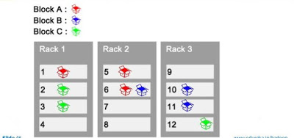
HDFS Replica and Rack Awareness
HDFS follows rack awareness for never loss all the data if entire rack fails.
Rules for Rack Awareness
Need to place the first replica of block in near
available rack
The second replica of block is not placed in
the same rack where the first replica is placed
The third replica should place in where the
second replica is placed but in the different node.

Slide 24
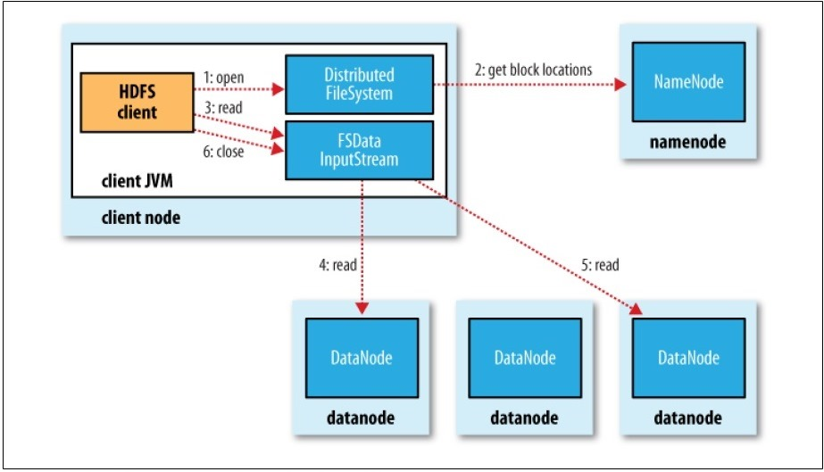
Data Flow: Anatomy of a File Read
To get an idea of how data flows between the client interacting with HDFS, namenode and datanodes

Slide 25
Data Flow: Anatomy of a File Read
The steps for reading data from HDFS:
Step-1: The client opens the file it wishes to read by calling open() on the FileSystem object, which for HDFS is an instance of DistributedFileSystem.
Step-2: DistributedFileSystem calls the namenode, using RPC,
To determine the locations of the blocks for the first few blocks in the file,
For each block, the namenode returns the addresses of the datanodes that have a copy of that block
The datanodes are sorted according to their proximity to the client.
Short-Circuit local reads → if client is its self a datanode
The DistributedFileSystem returns an FSDataInputStream (an input stream that supports file seeks) to the client for it to read data from.
FSDataInputStream in turn wraps a DFSInputStream, which manages the datanode and namenode I/O.
Step-3: The client then calls read() on the stream.

Slide 26
Data Flow: Anatomy of a File Read
The steps for reading data from HDFS:
DFSInputStream, which has stored the datanode addresses for the first few blocks in the file, then connects to the first (closest) datanode for the first block in the file
Data is streamed from the datanode back to the client, which calls read() repeatedly on the stream.
Step-5: When the end of the block is reached, DFSInputStream will close the connection to the datanode, then find the best datanode for the next block
Blocks are read in order with the DFSInputStream opening new connections to datanodes as the client reads through the stream.
Step-6: When the client has finished reading, it calls close() on the FSDataInputStream

Slide 27
Data Flow: Anatomy of a File Read
The steps for reading data from HDFS:
During reading, if the DFSInputStream encounters an error while communicating with a datanode, then it will try the next closest one for that block.
It will also remember datanodes that have failed so that it doesn’t needlessly retry them for later blocks.
The DFSInputStream also verifies checksums for the data transferred to it from the datanode.
If a corrupted block is found, it is reported to the namenode before the DFSInputStream attempts to read a replica of the block from another datanode.
The client contacts datanodes directly to retrive data with the help of namenode

Slide 28
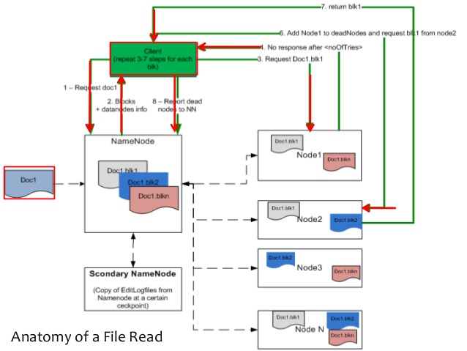
Data Flow: Anatomy of a File Read

Slide 29
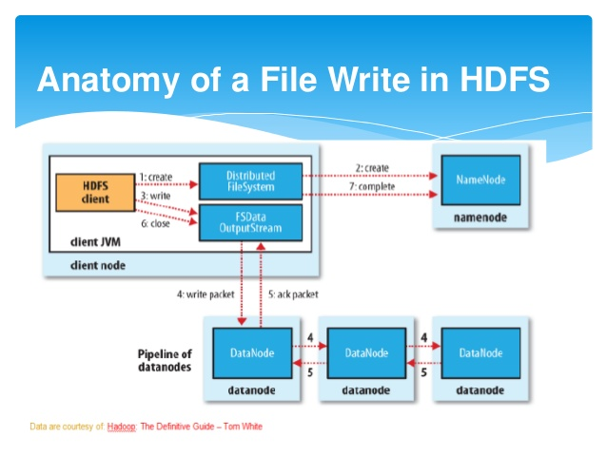
Data Flow: Anatomy of File Write

Slide 30
Data Flow: Anatomy of File Write
To write a file into HDFS, client needs to interact with name node
Namenode provides the address of the slave(Data node) on which client will start writing data
As soon as client finishes writing the block, the slave starts copying the block to another slave which in turn copy the block into another slave (default is 3)
After required replicas are created then it will send the acknowledgement to the client
Authentication process is same like file read

Slide 31
Data Flow: Anatomy of File Write
The steps to follows to write a file in HDFS:
Step-1: The client creates the file by calling create() on DistributedFileSystem.
Step-2: DistributedFileSystem makes an RPC call to the namenode to create a new file in the filesystem’s namespace, with # blocks associated with it.
The namenode performs various checks to make sure the file doesn’t already exist, and that the client has the right permissions to create the file
If these checks pass, the namenode makes a record of the new file; otherwise, file creation fails and the client is thrown an IOException.
The DistributedFileSystem returns an FSDataOutputStream for the client to start writing data to.
Step-3: As in the read case, FSDataOutputStream wraps a DFSOutputStream, which handles communication with the datanodes and namenode.
As the client writes data, DFSOutputStream splits it into packets, which it writes to an internal queue, called the data queue.

Slide 32
Data Flow: Anatomy of File Write
The steps to follows to write a file in HDFS:
The data queue is consumed by the DataStreamer, whose responsibility it is to ask the namenode to allocate new blocks by picking a list of suitable datanodes to store the replicas.
The list of datanodes forms a pipeline— assuming the replication level is three, so there are three nodes in the pipeline.
Step-4: The DataStreamer streams the packets to the first datanode in the pipeline, which stores the packet and forwards it to the second datanode in the pipeline.
Similarly, the second datanode stores the packet and forwards it to the third (and last) datanode in the pipeline.
DFSOutputStream also maintains an internal queue of packets that are waiting to be acknowledged by datanodes, called the ack queue.
Step-5: A packet is removed from the ack queue only when it has been acknowledged by all the datanodes in the pipeline

Slide 33
Data Flow: Anatomy of File Write
The steps to follows to write a file in HDFS:
It’s possible, but unlikely, that multiple datanodes fail while a block is being written. As long as dfs.replication.min replicas (default one) are written, the write will succeed, and the block will be asynchronously replicated across the cluster until its target replication factor is reached (dfs.replication, which defaults to three).
Step-6: When the client has finished writing data, it calls close() on the stream.
Step-7: This action flushes all the remaining packets to the datanode pipeline and waits for acknowledgments before contacting the namenode to signal that the file is complete.
The namenode already knows which blocks the file is made up of (via Data Streamer asking for block allocations), so it only has to wait for blocks to be minimally replicated before returning successfully.
HDFS provides a method for forcing all buffers to be synchronized to the datanodes via the sync() method on FSDataOutputStream.
Writes the blocks in parallel manner
Writes the replicas in sequential manner
Writing blocks follows the rack awareness rules.

Slide 34
HDFS : Blocks
Disk has block size --> minimum amount of data that can be read or write.
Filesystem blocks are typically a few kilobytes in size, whereas disk blocks are normally 512 bytes.
The HDFS also uses blocks concepts to read and write a file.
The block size is 128MB by default.
Files in HDFS are broken into block-sized chunks, which are stored as independent units.
A file in HDFS that is smaller than a single block does not occupy a full block’s worth of underlying storage. → a 1 MB file stored with a block size of 128 MB uses 1 MB of disk space, not 128 MB.

Slide 35
HDFS : Blocks
Why is a HDFS block is so large?
HDFS blocks are large compared to disk blocks to minimize the cost of seek time.
If block is large then the time it takes to transfer data from the disk can be significantly longer than the time to seek to start of the block.
Thus, transferring a large file made of multiple blocks operates at the disk transfer rate.
Example:
The seek time is 10 ms and transfer rate is 100MB
To make seek time 1 % of the transfer time, we need to make a block size of 100MB. Here 128MB.
Map task in MapReduce operate on one block at a time, so if you have too few tasks (fewer than nodes in the cluster), your jobs will run slower than they could otherwise.

Slide 36
HDFS : Blocks
HDFS blocking benefits
A file can be larger than any single disk in the network.
There’s nothing that requires the blocks from a file to be stored on the same disk, so they can take advantage of any of the disks in the cluster.
Making the unit of abstraction a block rather than a file simplifies the storage subsystem.
The storage subsystem deals with blocks,
simplifying storage management (blocks are fixed size, it is easy to calculate how many can be stored in disk)
Eliminating metadata concerns ( file metadata such as file permissions are not required, because blocks are chunks of data)
Blocks fit well with replication for providing fault tolerance and availability.

Slide 37
HDFS : Blocks
HDFS block caching
Frequently accessed files the blocks may be explicitly cached in the datanode memory → off-heap block cache.
By default, a block is cached in only one datanode’s memory, although the number is configurable on a per-file basis.
Job schedulers uses cached blocks by running tasks on the datanode to increase the read performance.
A small lookup table used in a join is a good candidate for caching.
Users or applications instruct the namenode which files to cache by adding a cache directive to a cache pool.
Cache pools are an administrative grouping for managing cache permissions and resource usage

Slide 38
HDFS : Blocks
HDFS Federation:
Namenode keeps a reference to every file and block in the filesystem in memory --> memory becomes the limiting factor for scaling.
HDFS federation, introduced in the 2.x release series, allows a cluster to scale by adding Namenodes, each of which manages a portion of the filesystem namespace.
Example: one Namenode manages all the files in /user and another Namenode manages all the files in /share.
Namespace Volume:
It made up of the metadata for the namespace and a block pool containing all the blocks for the files in the namespace.
Each Namenode manages Namespace volume and these are independent of each other. → Namenode do not communicate with one other and failure of one Namenode does not affect the availiability of namespace managed by other namenodes.

Slide 39
HDFS : Blocks
HDFS High Availability:
The combination of replicating namenode metadata on multiple filesystems and usage of secondary namenode to create a check-points → not provide high availability of the file system.
Namenode is a single point of failure (SPOF).
If Namenode fails, then whole Hadoop system will be out of service until new Namenode could be brought online.
To recover from a failed Namenode, the administrator starts new primary Namenode with one of the filesystem metadata replicas and configures datanodes and clients to use this new namenode.
The new Namenode is not able to serve request until it has
loaded its namespace image into memory
replayed its edit log
received enough block reports from the datanodes to leave safe mode
On large cluster, the time taken by the new name to provide services about more than 30

Slide 40
HDFS : Blocks
HDFS High Availability:
This is a long recovery time (Down time).
Hadoop – 2 uses stand-by concept to provide High Availabilty.
In this implementation, there are a pair of Namenodes in an active-standby configuration.
In the event of the failure of the active namenode, the standby takes over its duties to continue servicing client requests without a significant interruption.
A few architectural changes are needed to follow to this happen:

Slide 41
HDFS : Blocks
HDFS High Availability:
A few architectural changes are needed to follow to this happen:
The Namenodes must use highly available shared storage to share the edit log. → This shared edit logs can be used by standby Namenode for synchronize it states with the active Namenode.
Datanodes must send block reports to both Namenodes because the block mappings are stored in a Namenode’s memory, and not on disk.
Clients must be configured to handle namenode failover, using a mechanism that is transparent to users.
The secondary Namenode’s role is subsumed by the standby, which takes periodic checkpoints of the active namenode’s namespace.

Slide 42
MapReduce Overview
Programming model used by Google
MapReduce offers a solution to existing problems by bringing computation close to data thereby minimizing data movement
A combination of the Map(transformed) and Reduce(aggregated) models with an associated implementation
It is a simple programming model designed to process large volumes of data in parallel by dividing the job into a set of independent tasks.
MapReduce is highly scalable and can be used across many computers.
Many small machines can be used to process jobs that normally could not be processed by a large machine.
Limitation of Map-Reduce Programming
Map and Reduce jobs are stateless. → reduce jobs have to wait for map jobs to be complet first → limits the maximum parallelism → YARN born

Slide 43
MapReduce Overview
MapReduce is the key algorithm that the Hadoop data processing engine uses to distribute work around a cluster.
Decomposing the data processing applications into mappers and reducers is sometimes non-trivial.
Once the application have written in map-reduce form, scaling the application over cluster is a just a configuration change only.

Slide 44
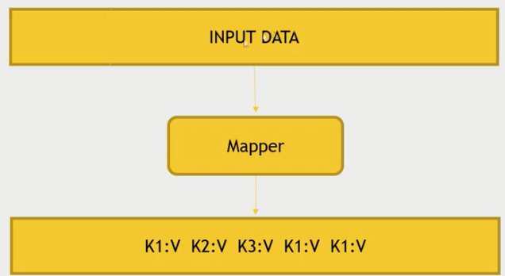
Map Abstraction
The Mapper converts raw source data into key/value pairs
Inputs a key/value pair
Key is a reference to the input value
Value is the data set on which to operate
Evaluation
Function defined by user
Applies to every value in value input
Might need to parse input
Produces a new list of key/value pairs
Can be different type from input pair

Slide 45
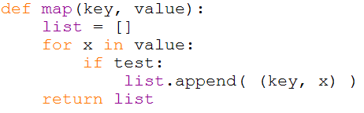
Map Example

Slide 46
Distributed Grep
Split data
grep
matches
Very
big
data
Split data
grep
matches
cat
All
matches
Split data
grep
matches
Split data
grep
matches

Slide 47
Distributed Word Count
Split data
count
count
Split data
count
count
Very
big
data
merged
count
Split data
count
count
merge
Split data
count
count

Slide 48
Map+Reduce
R
E
D
U
C
E
Very
big
data
M
A
P
Partitioning
Function
Result
Reduce :
Accepts intermediate key/value* pair
Emits output
Map:
Accepts input key/value pair
Emits intermediate key/value pair

Slide 49
Reduce Abstraction
Starts with intermediate Key / Value pairs
Ends with finalized Key / Value pairs
Starting pairs are sorted by key
Iterator supplies the values for a given key to the Reduce function.
Typically a function that:
Starts with a large number of key/value pairs
One key/value for each word in all files being greped (including multiple entries for the same word)
Ends with very few key/value pairs
One key/value for each unique word across all the files with the number of instances summed into this entry
Broken up so a given worker works with input of the same key.

Slide 50
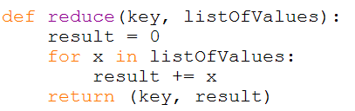
Reduce Example

Slide 51
How Map and Reduce Work Together

Slide 52
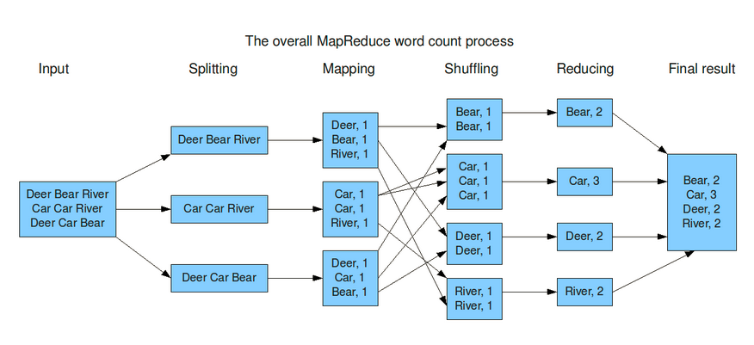
Mapreduce Example

Slide 53
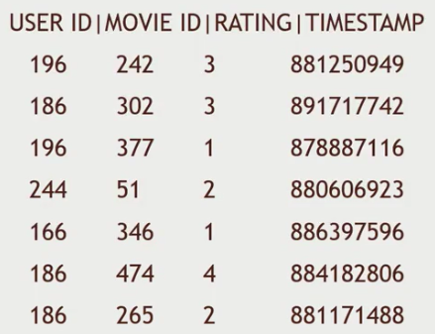

Map Reduce Example - 2
Dataset : MovieLens dataset
How many movies did each user rate in the MovieLens dataset?

Slide 54
Map Reduce Example - 2
Key will be the UserID
Values will be MovieID → aggregating

Slide 55
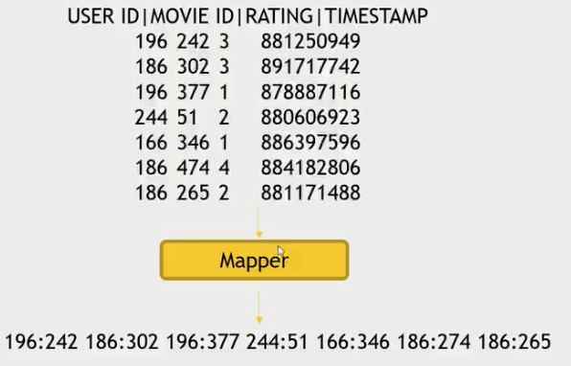
Map Reduce Example - 2
Map users to movies they watched:

Slide 56
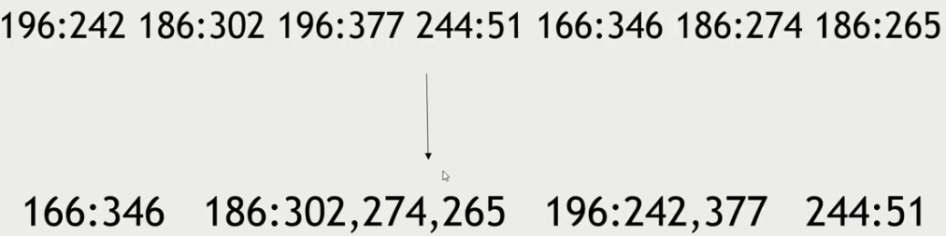
Map Reduce Example - 2
Map-Reduce sorts and groups the mapped data (“Shuffle and Sort”)

Slide 57
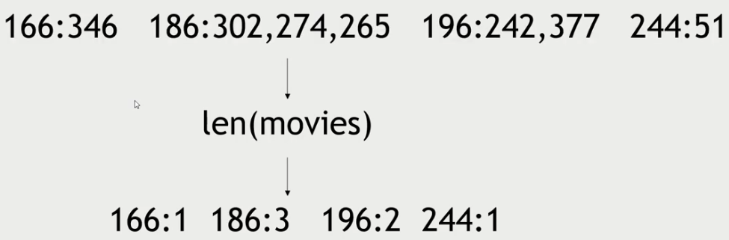
Map Reduce Example - 2
Reducer Process each key’s values

Slide 58
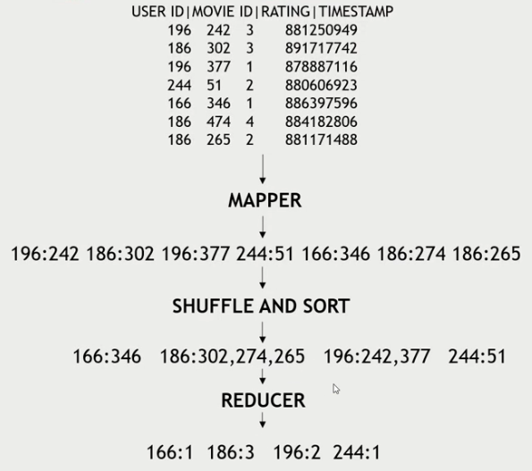
Map Reduce Example - 2
Final

Slide 59
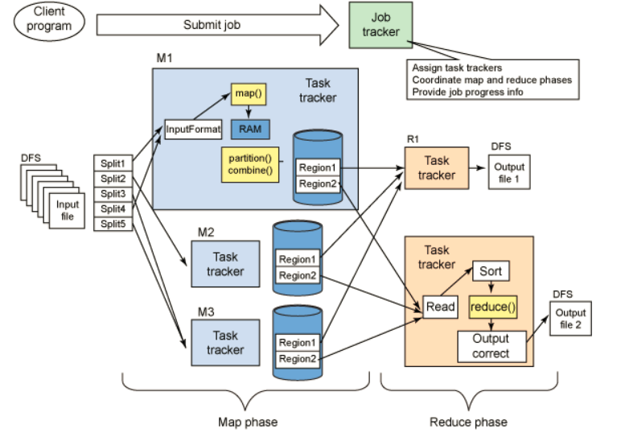
Mapreduce data flow

Slide 60
Map Reduce Summary
A High level abstracted framework for distributed processing of large datasets
Fault Tolerant , Parallelization
Computation consists of two phases
Map
Reduce
A Master-Slaves architecture
Computations occurs in multiple slave nodes
And it tries to provide data locality as much as possible.

Slide 61
Hadoop MapReduce -1 Daemons
JobTracker
Client submits the computation to JobTracker
Assign a task to the TaskTracker who has free slots and where data is stored if possible
It tries to provide data locality as much as possible.
TaskTracker
Spawns a JVM process for each input split as directed by Job Tracker
Send periodic heartbeats to Job Tracker

Slide 62
Terminology
Job
A complete user defined computation or program.
A full program -- an execution of a Mapper and Reducer across a data set
Tasks
A subset of computation.
Can be either execution of MAP or REDUCE on a slice of data.
Task in Progress (TIP)
Task Attempt
An attempt to run a task.
If an attempt fails, Job Tracker tries to start an another task attempt for the same task.
By Default, total number of task attempts for a task is four.
If the same input causes crashes over and over, that input will eventually be abandoned

Slide 63
Terminology

Slide 64
Terminology
Master node runs JobTracker instance, which accepts Job requests from clients.
TaskTracker instances run on slave nodes.
TaskTracker forks separate Java process for task instances.
Job Distribution:
MapReduce programs are contained in a Java “jar” file + an XML file containing serialized program configuration options
Running a MapReduce job places these files into the HDFS and notifies TaskTrackers where to retrieve the relevant program code

Slide 65
Input file
1,senthil,paracetamol,male,100
2,kumar,metacin,male,70
3,priya,avil,female,50
4,pradeep,paracetamol,male,25
5,siva,avil,male,45
6,saravana,metacin,male,150
b0
k1 , v1
0 1,senthi,……..,100
2,kumar,………,70
53 3,priya,…………,50
k2 , v2
paracetamol 100
metacin 70
avil 50
b1
b0
map
k3 , v3
avil 50,45
metacin 70,150
paracetamol 100,25
Input
file
shuffle
1.Sorting by key
2.Grouping by key
k4 , v4
avil 95
metacin 220
paracetamol 125
reduce
map
b1
query
select drug,sum(amount) from patient group by drug;
k1 , v1
4,pradeep,………,25
5,siva,…………..,45
96 6,saravana,………,150
k2 , v2
paracetamol 25
avil 45
metacin 150

Slide 66
Anatomy of MR code
Mapper - a Java class to be extended by the developer
Methods – setup, map, run, cleanup
Map method takes a key value and can emit zero or more intermediate key value pairs depending upon the logic implemented by the developer
A JVM running Mapper is launched for each input split.
Reducer – A Java class to be extended by the developer
Methods – setup, reduce, run, cleanup
Reduce method takes a (intermediate key-list of values) and can emit zero or more key value pairs depending upon the logic implemented by the developer
Driver
Configures the job and submits the job to the cluster from the client.

Slide 67


